Slide 1
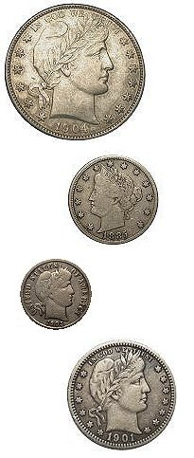
Welcome to the Barber Coin Collectors’ Society (BCCS)

Slide 2
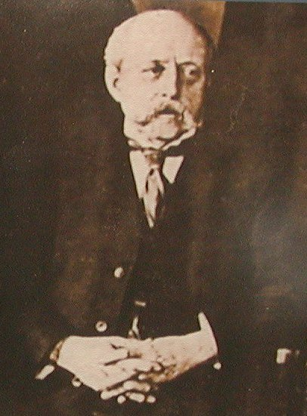
Charles Edward Barber
1840: Born in London England
Designer, engraver and die maker
1852: Moved to Philadelphia with father, William Barber
1869-1879: Assistant Engraver
1880-1917: Chief Engraver
Patterns, medals, regular issue silver and nickel coinage, commemoratives, and Hawaii, Dominican, and Cuban issues

Slide 3
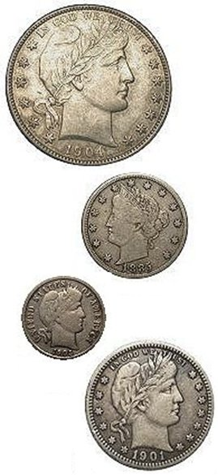
Barber Coin Collectors’ Society
Collectors of coins designed by Charles E. Barber
Chief Engraver of the U.S. Mint 1880-1917
4 series
Liberty Head (Barber) Dimes
Barber Quarters
Barber Halves
Liberty Nickels

Slide 4
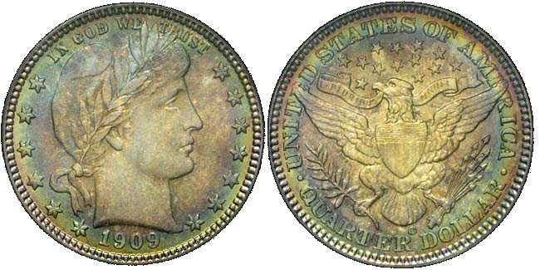
Barber Coin Collectors’ Society
Founded in 1989
250+ members who enjoy Barber coinage
Barber coinage experts
Research, education and social interactions
Dues are $15 per year.
~ 20 Regional Meeting events per year
2015 and 2016 Officers
John Frost, President
Carl Feldman, Vice President
Dave Earp, Secretary/Treasurer

Slide 5
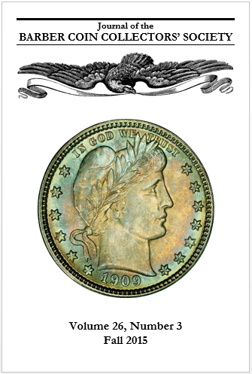
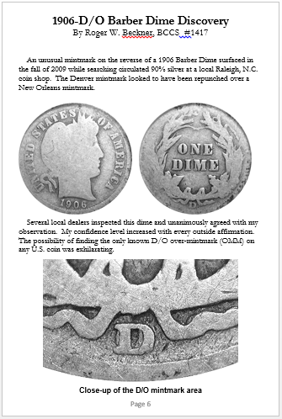
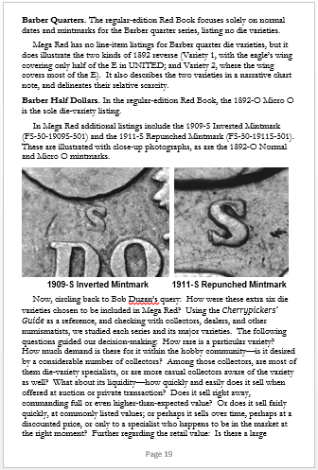
Journal of the Barber Coin Collectors’ Society
Published 4 times per year
John Frost, Editor 2015-
Detailed Research, Collecting Notes, Surveys, Club Member Stories

Slide 6
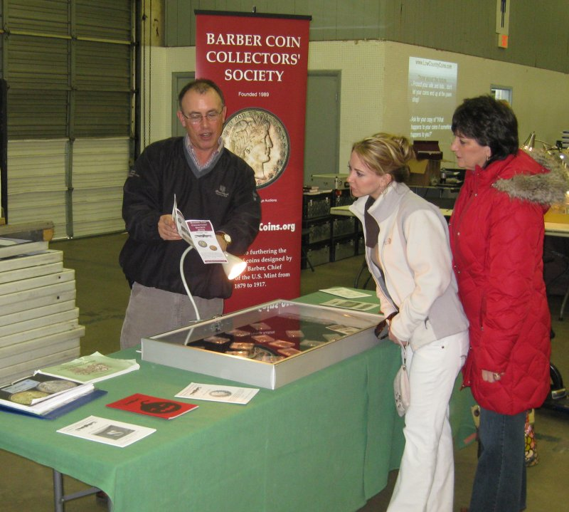
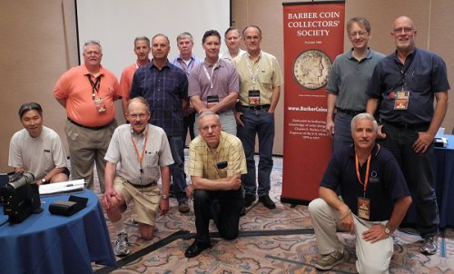
Regional Meetings
Social opportunities
~20 events annually nationwide
FUN, ANA, Baltimore, Long Beach, Manchester NH, Bay State, Rochester, Charlotte, Knoxville, Houston

Slide 7
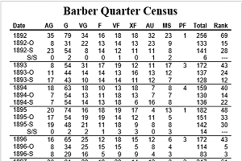
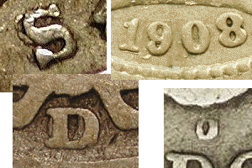
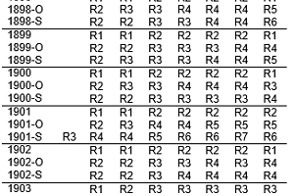
Projects
Population census studies for all four series
Rarity Survey for all series → Rarity Ratings for each issue, for each grade
Varieties Surveys for all series (in progress)

Slide 8
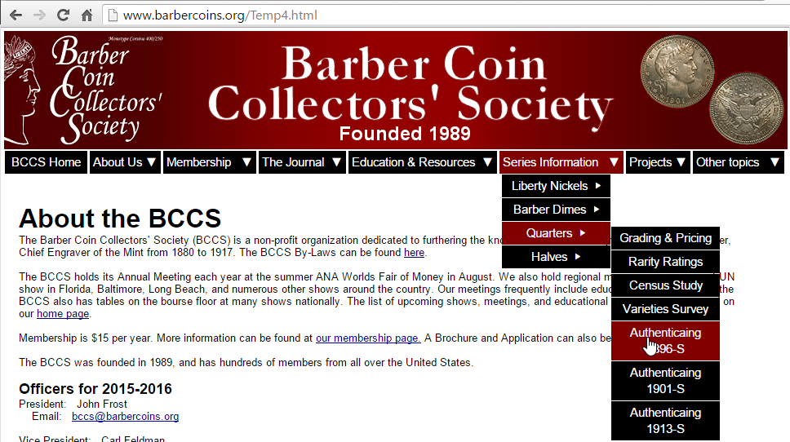
www.BarberCoins.org
Information about BCCS
Brochure and member application
Sample Journal
List of upcoming meetings
Information on all 4 series
Grading, links to values
Authentication of “Big 3” quarters
Rarity Ratings by date and grade
Census/Survey Reports
Contemporary Counterfeits page
Member Gallery (coin images)
Barber Patterns and Medals
Links to online references

Slide 9
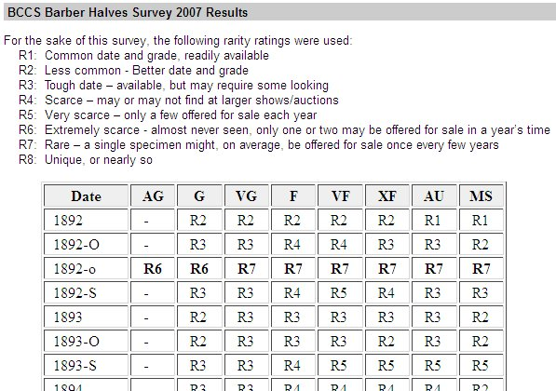
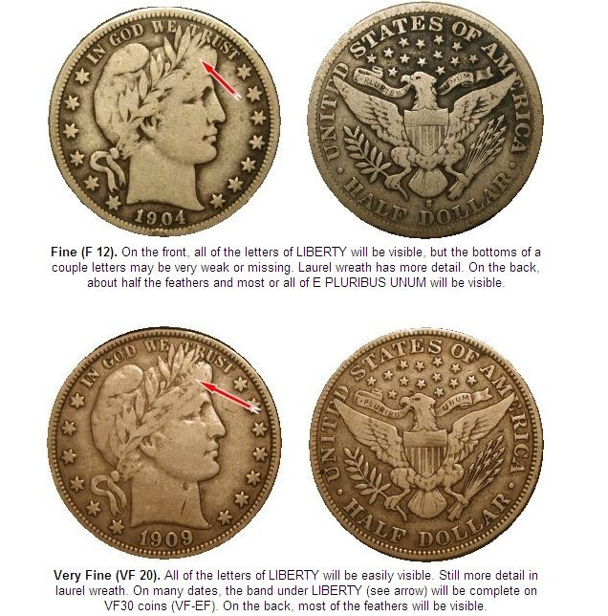
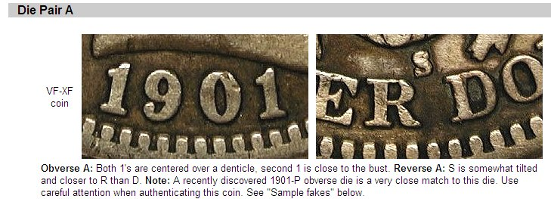
Website – Series information

Slide 10
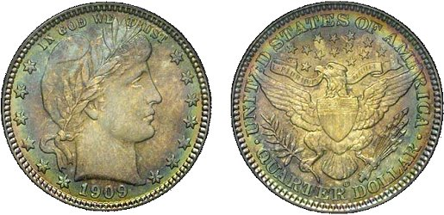
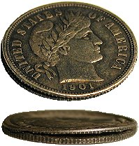
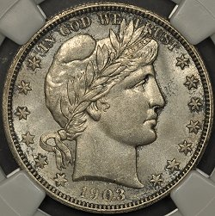
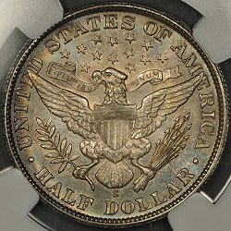
Website – Members Gallery

Slide 11
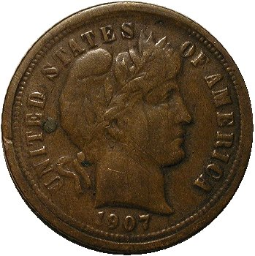
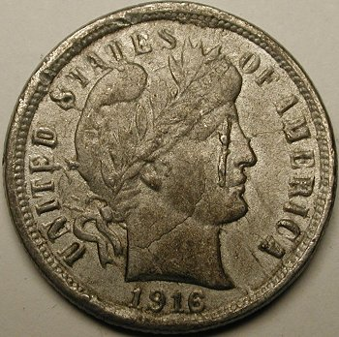
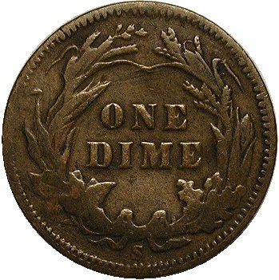
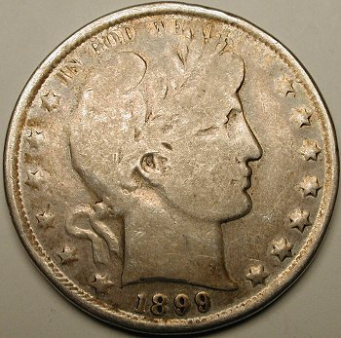
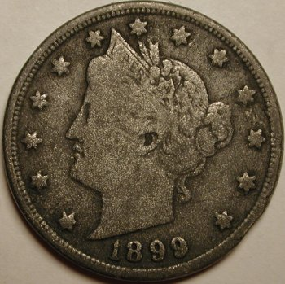
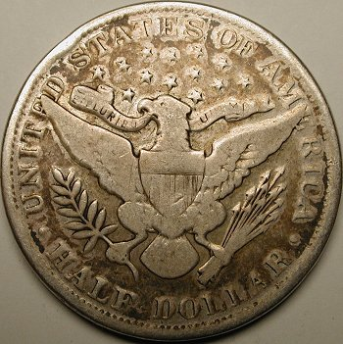
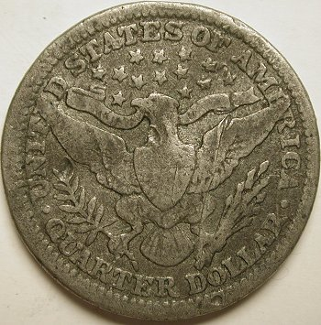
Website – Contemporary counterfeits

Slide 12
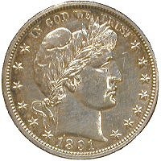
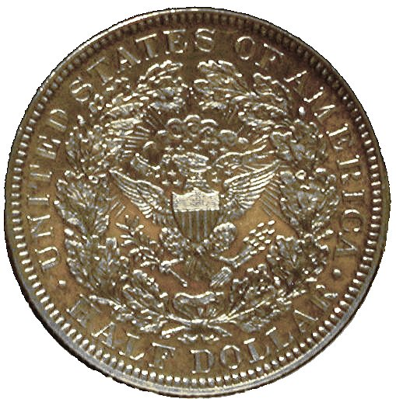
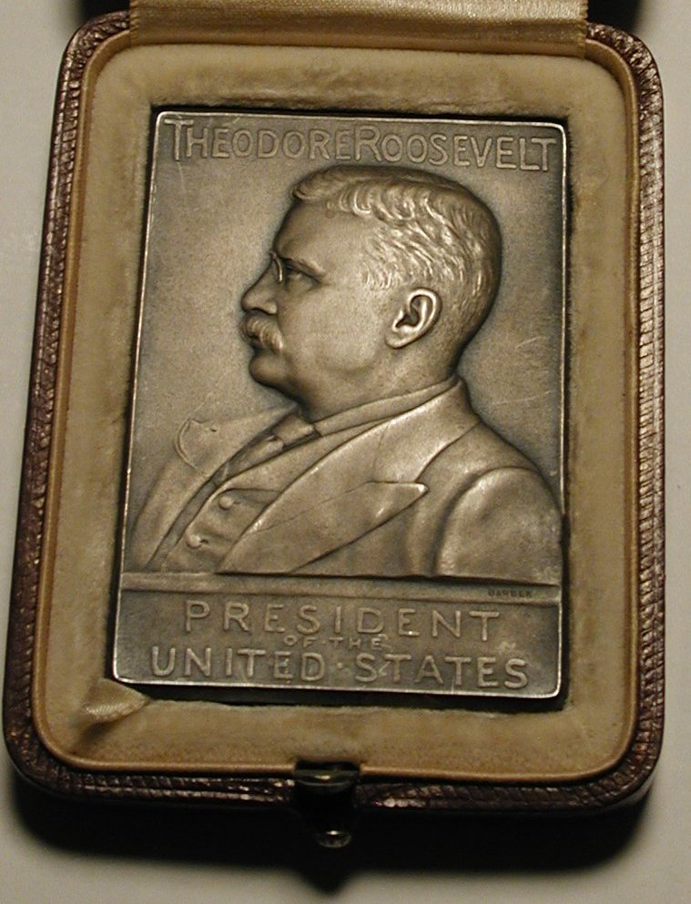
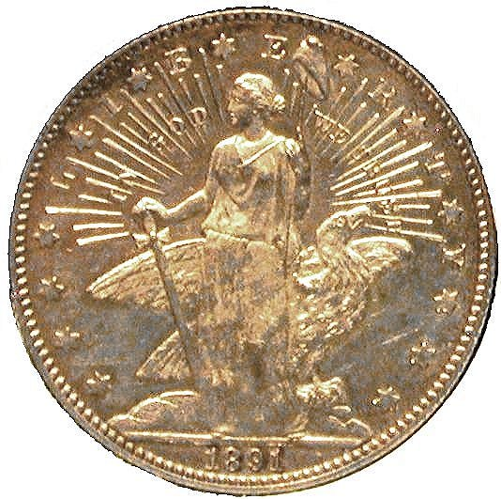
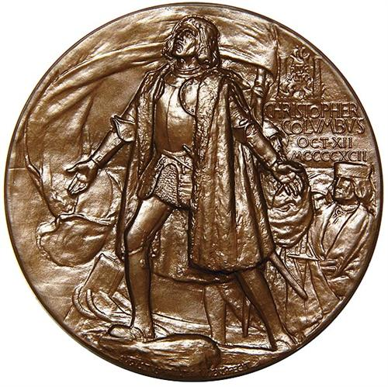
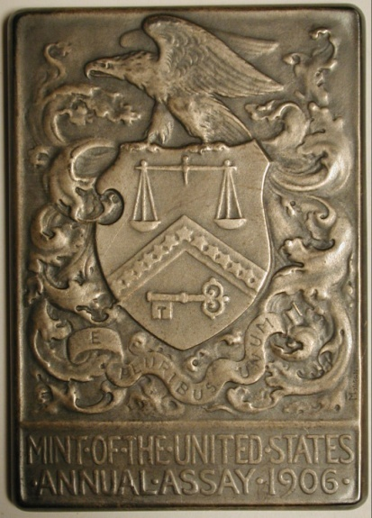
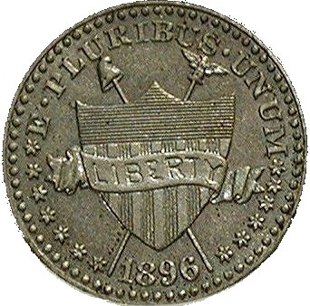
Website – Patterns and Medals

Slide 13
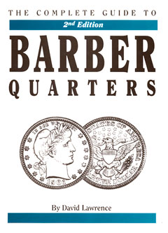
Website – Online references
DLRC Press – DavidLawrence.com
Complete Guide to Barber Dimes
Complete Guide to Barber Quarters, 2nd Edition
Complete Guide to Barber Halves
Complete Guide to Shield and Liberty Nickels
Links to these books from our website

Slide 14
Thank you!
Questions?

